Slide 1


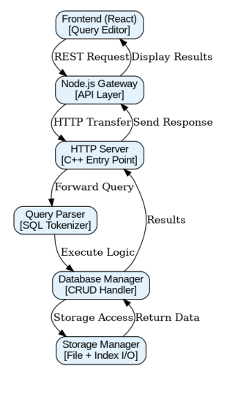





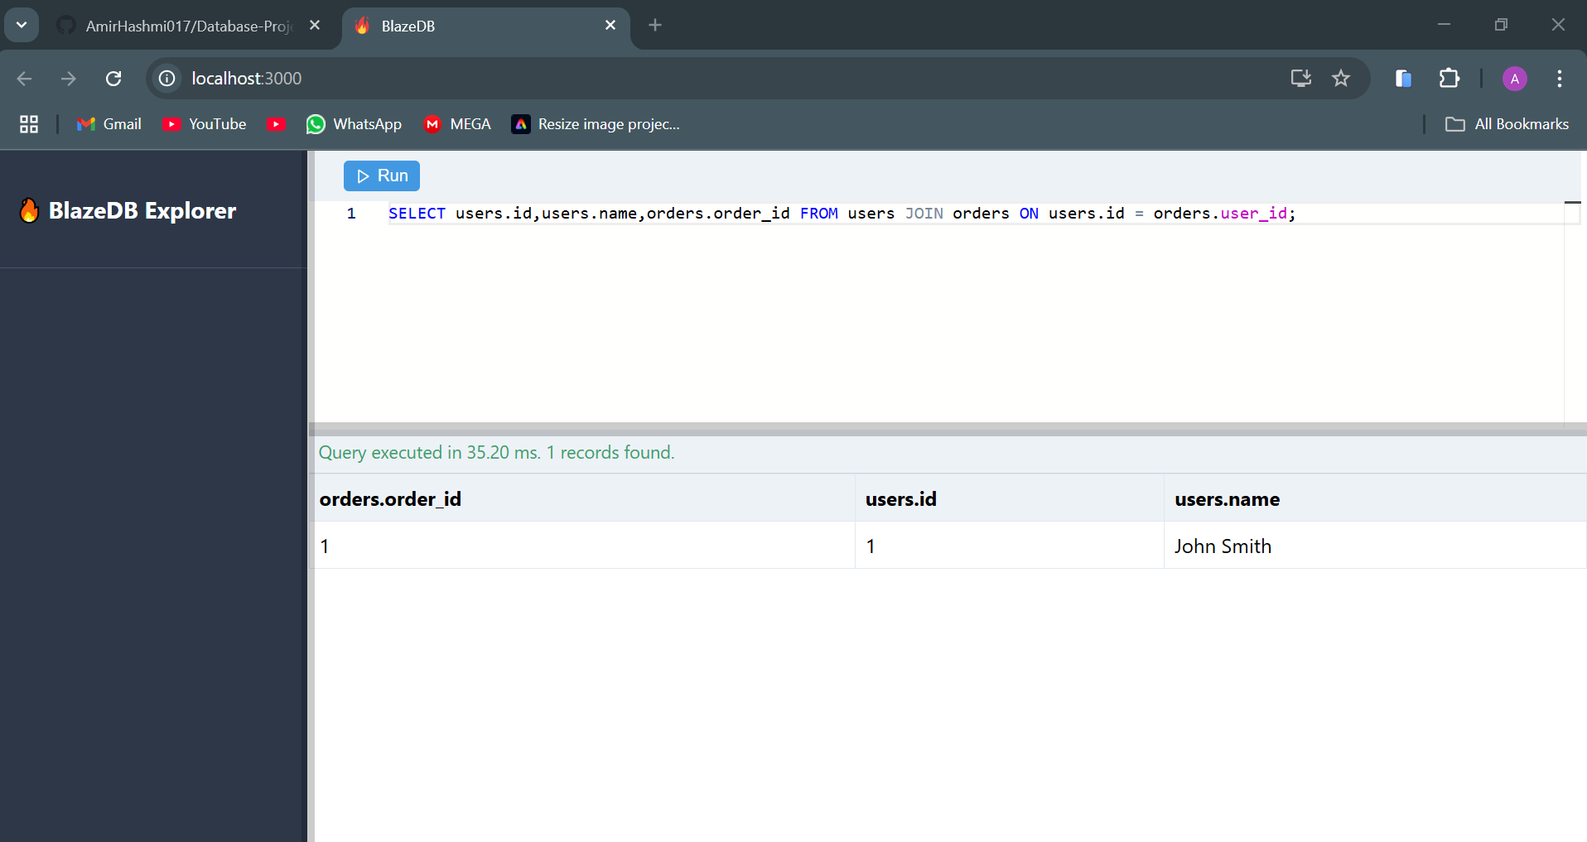
BlazeDB: Lightweight High-Performance DBMS
Supervisor Name: Dr. Atif Hussain
Course: CSC-207 Advanced Database Management System
Department of Computer Science, University of Engineering & Technology, Lahore
Project Overview
Flow Diagram
BlazeDB is a lightweight, high-performance custom Database Management System (DBMS) built entirely from scratch. Designed with educational and experimental objectives in mind, it demonstrates how core components of a DBMS such as data storage, query processsing, indexing, and front-end interaction work together. It features a custom file-based storage engine, B+ Tree indexing for efficient data retrieval, and a simplified SQL-like query language that supports essential CRUD operations and joins.
Key Features
Custom Storage Engine: Tables stored efficiently in .dat (data) and .idx (index) files
B+ Tree Indexing: O(log n) operations for fast data retrieval and manipulation
SQL-like Query Language: Support for CREATE, INSERT, SELECT, UPDATE, DELETE, JOIN
Transaction Management: ACID properties (Atomicity, Consistency, Isolation, Durability)
Interactive Frontend: React-based query editor with syntax highlighting
CRUD Operations: CREATE, DROP (databases & tables) INSERT, UPDATE, DELETE, SELECT (with WHERE clauses)
Joins: Joins for multi-table queries
Logical Operators: Supports AND, OR, NOT, LIKE operators
Relational Integrity & Data Types: Primary and Foreign Key enforcement with multiple data types (INT, VARCHAR, FLOAT)
Tech Stack
WireFrames
Data Structure and Storage
File Structure:
mydb/ (Database Folder)
|── catalog.bin (Schema Metadata)
── employees.dat (Table Records)
└── employees.idx (B+ Tree Indexes)
B+ Tree Node Structure:
cppstruct BPlusNode {
bool is_leaf;
int parent;
std::vector<int> keys;
std::vector<int> children; // Non-leaf nodes
std::vector<int> data_ptrs; // Leaf nodes
};
Sample Queries
Create and Drop Database
CREATE DATABASE skylines;
USE skylines;
DROP DATABASE skylines;
Create and Drop Table
CREATE TABLE users (id INT, name STRING(50), age INT, PRIMARY
KEY (id));
DROP TABLE users;
CRUD Operations on Table
INSERT INTO users VALUES (1, 'John Doe', 30);
UPDATE users SET name = 'John Smith' WHERE id = 1;
DELETE FROM users WHERE age < 30;
SELECT users.id,users.name,orders.order_id FROM users JOIN
orders ON users.id = orders.user_id WHERE users.id = 1 and
users.name = ‘Amir’;
Future Directions
To further improve BlazeDB, the following features are planned:
Advanced Data Types
Support for JSON and BLOB to handle unstructured and large binary data.
Improved User Experience
Drag-and-drop UI for schema design and query building.
CSV import/export for seamless data migration.
Query Optimization & Performance
Cost-based query planner for efficient JOIN execution.
Caching mechanism for frequently accessed data.
Project Team
Salman Anas (2023-CS-06)
Amir Hashmi (2023-CS-11)
Muhammad Talha (2023-CS-12)
Mahad Sheraz (2023-CS-36)
References
GitHub: https://github.com/AmirHashmi017/DBMS-From-Scratch

